Slide 1



DATA VISUALTION CA2: PART B
Chan Shuo Kai (P2300533)
DAAA/FT/2A21

Slide 2


OBJECTIVE
Discover ways to adjust fares and improve routes across MRT, LRT, buses, and taxis. Analyse the relationship between distance length and commuters.
The goal is to make short trips cheaper, improve connections, and reduce congestion.

Slide 3


DATASET USAGE
daily_ridership
mrt_fares
trip_distance
This dataset shows the average distance per trip for different modes of transportation (MRT, LRT, Bus, Taxi) over the years.
This dataset outlines adult card fares for MRT and LRT travel before 7:45 am on weekdays and all other timings, with fare amounts ranging from 69 to 109 based on different distance ranges (e.g., "Up to 3.2 km," "3.3 km - 4.2 km").
This dataset shows the average distance per trip for different modes of transportation (MRT, LRT, Bus, Taxi) over the years.
LRT has values 0 in multiple years such as 1995 and 1996.
This is because LRT had not been introduced until 1999 which means there was no data to collect.
Applicable time only has two values: Before 7:45 AM (Weekdays excluding public holidays) and After 7:45 AM.
This is because MRTs offer pre-peak hours discounts to commuters before 7.45am.

Slide 4


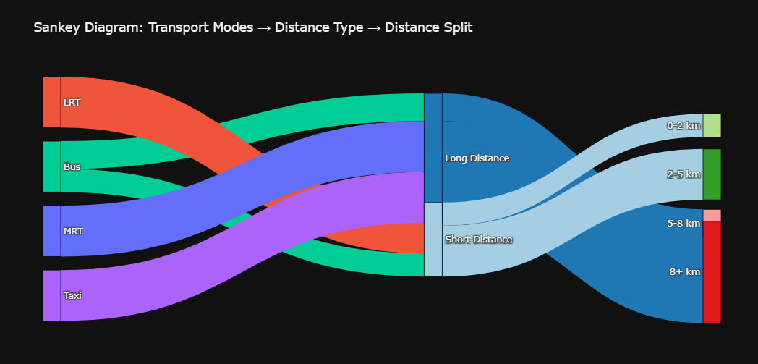
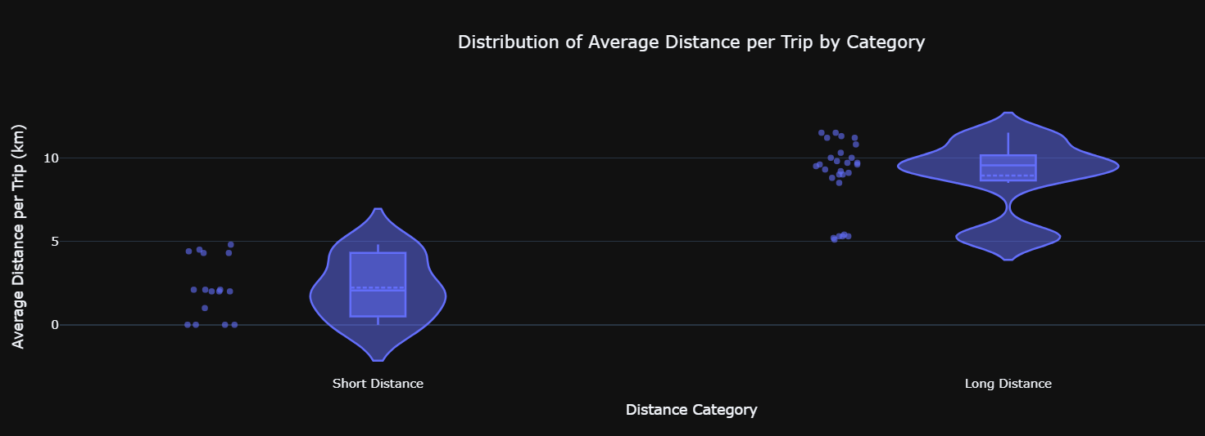
ANALYSIS OF TRIP DISTANCES
SANKEY CHART INSIGHTS
Buses and Taxis are the modes present in both shorter trips and longer trips while LRT and MRT are primarily used for short and long trips respectively.
We can see that most short trips fall in the 2-5 km range, while long trips are typically over 8 km.
The 0-2 km range is smaller, likely due to the preference for walking or cycling for such short distances.
This shows MRT’s central role in long commutes, with Buses and Taxis complementing shorter journeys.
VIOLIN PLOT INSIGHTS
Short-distance trips mostly cluster around 1-5 km, with minimal extreme values. In contrast, long-distance trips tend to center around 8-12 km, but with a broader spread. The short-distance trips show more density at lower values, while long trips exhibit more variation but peak around the 10 km range. This suggests that most commuters take shorter trips, likely for daily commutes, while long-distance trips are less common but still significant.

Slide 5
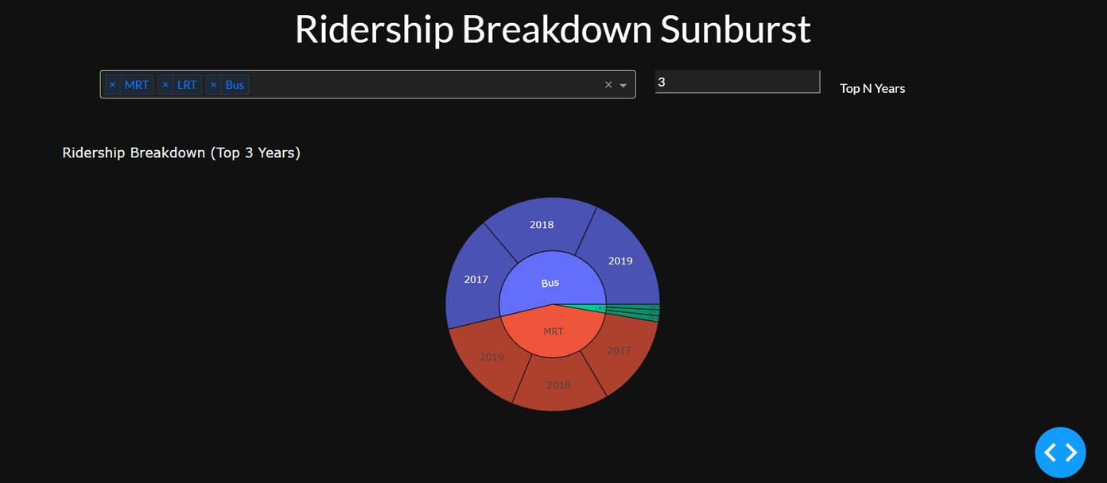
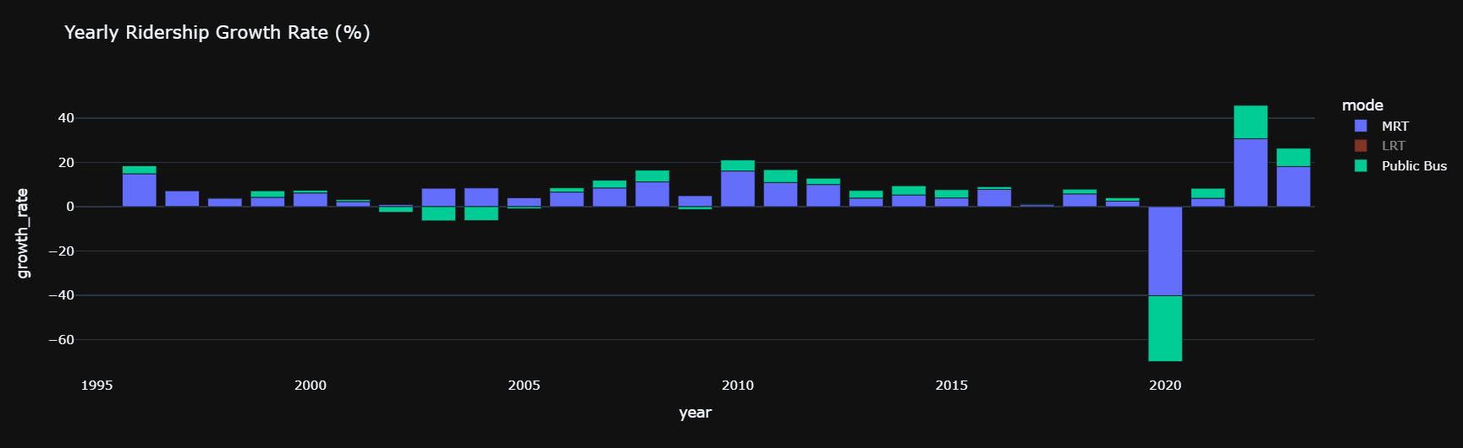
RIDERSHIP BREAKDOWN
SUNBURST CHART INSIGHTS
Public Buses (blue) as the dominant mode, with MRT (red) holding a significant share across the top 3 years. LRT (green) plays a smaller role, while MRT and Buses lead in meeting public transport needs. 2017-2019 were peak ridership years, showing strong transport demand before COVID-19.
BARCHART INSIGHTS
MRT is often prioritised by the governemnt with expansions every few years indicative of the growth changes seen in the bar chart. Bus being the secondary option still sees consistent growth each year. This means that MRT requires heavy investment and constant evaluation in order to maintain its growth. Buses may be seen as a more reliable option compared to MRT.
Ridership for MRT, LRT, and Public Buses grew steadily until 2020, when COVID-19 caused a sharp decline. Afterward, ridership rebounded, indicating a post-pandemic recovery. MRT (blue) showed the most fluctuations, likely due to expansions or repairs, while Public Buses (green) and LRT (brown) maintained more stable ridership trends.

Slide 6

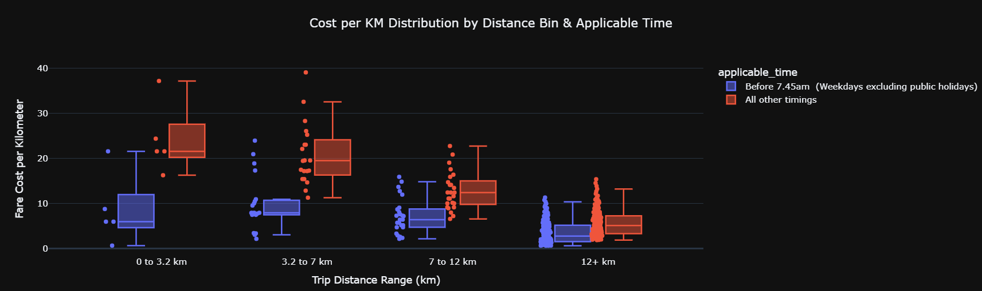
COST/KM DISTRIBUTION BY DISTANCE AND APPLICABLE TIME
We can see that most commuters prefer long distance travels by the concentration of data points at 7km-12km and especially 12+km.
BOXPLOT INSIGHTS
Fare costs vary significantly by travel time, with lower fares before 7:45 am to reduce peak congestion. Shorter trips (0-3.2 km) are more expensive per km due to minimum fare policies, while longer trips are more cost-effective.
This pricing structure encourages early commuting and favors longer trips, promoting efficient cross-city travel while potentially discouraging short-distance public transport use in favor of walking or cycling.
Short-distance trips (0-7 km) have higher variability in cost per km, often making them more expensive, which may discourage public transport use for shorter trips. Long-distance trips (12+ km) have stable, predictable costs, supporting affordability for commuters.

Slide 7
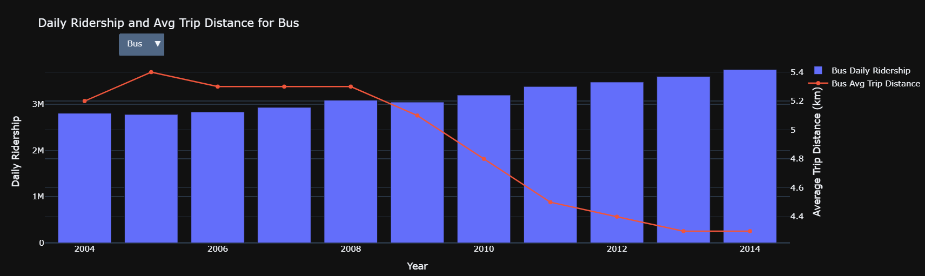
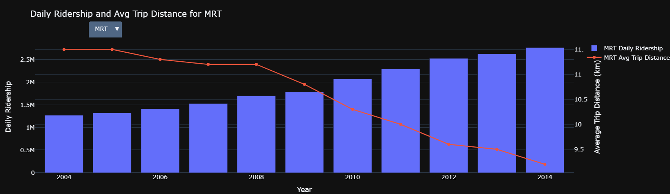
Daily Ridership and Average Trip Distance
BAR CHART INSIGHTS
The bar chart shows rising daily ridership for both MRT and buses, indicating growing reliance on public transport, driven by population growth and expanded networks. The line graph reveals that average trip distances have been decreasing, with MRT trips dropping from 11 km to 9.5 km and bus trips from 5.3 km to 4.3 km.
This could reflect MRT expansion and improved last-mile connectivity allow for shorter, more direct trips.
Alternatively, short-distance fares are higher per km but commuters still choose convenience over cost for shorter trips.

Slide 8

KEY TAKEAWAYS AND RECOMMENDATIONS
SHORT TERM IMPLEMENTATION
LONG TERM IMPLEMENTATION
Feeder Services & Micro-Mobility
  For the 0–2 km Range: Establish or expand feeder bus services and micro-mobility options (e.g., e-scooters, bike-sharing) around transit hubs to cover areas where walking or cycling is currently preferred.
  Dedicated Transfer Hubs: Create or upgrade transfer stations with clear signage and minimal walking distances between connecting transport modes.
Dynamic Short-Trip Pricing:
  Implement a dynamic pricing model that reduces the minimum fare or adjusts the per-kilometer charge for trips under 3–5 km. This may involve tiered fare bands that automatically lower costs for short-distance journeys, encouraging more users to choose public transport over private vehicles.
First/Last-Mile Service Scheduling
  Syncing with Transit Timetables: Coordinate micro-mobility and ride-hailing service schedules with public transit timetables to minimise waiting times. For example, schedule additional e-scooter availability during peak hours around major stations.
  On-Demand Shuttles: Introduce on-demand shuttle services in areas with lower density micro-mobility coverage. These shuttles can serve as a flexible link between residential clusters and transit hubs.

Slide 9
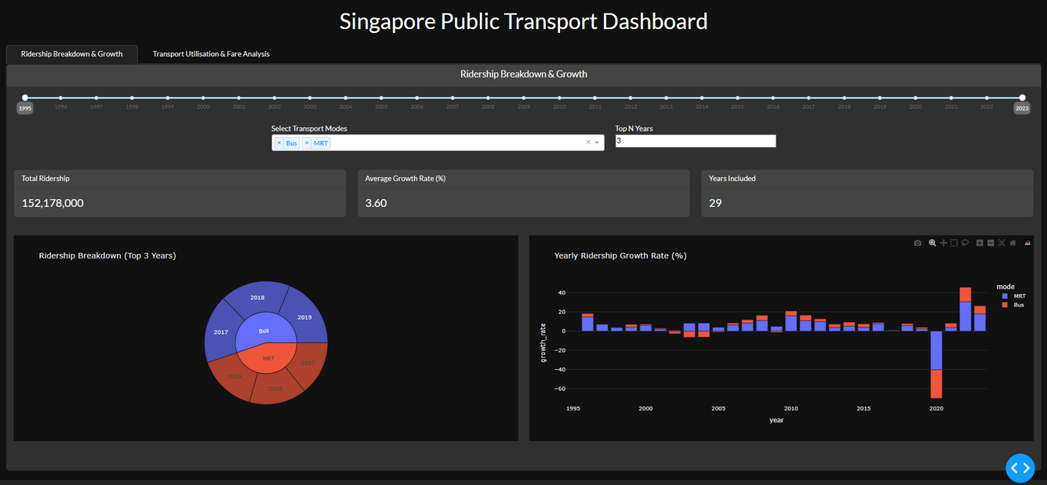

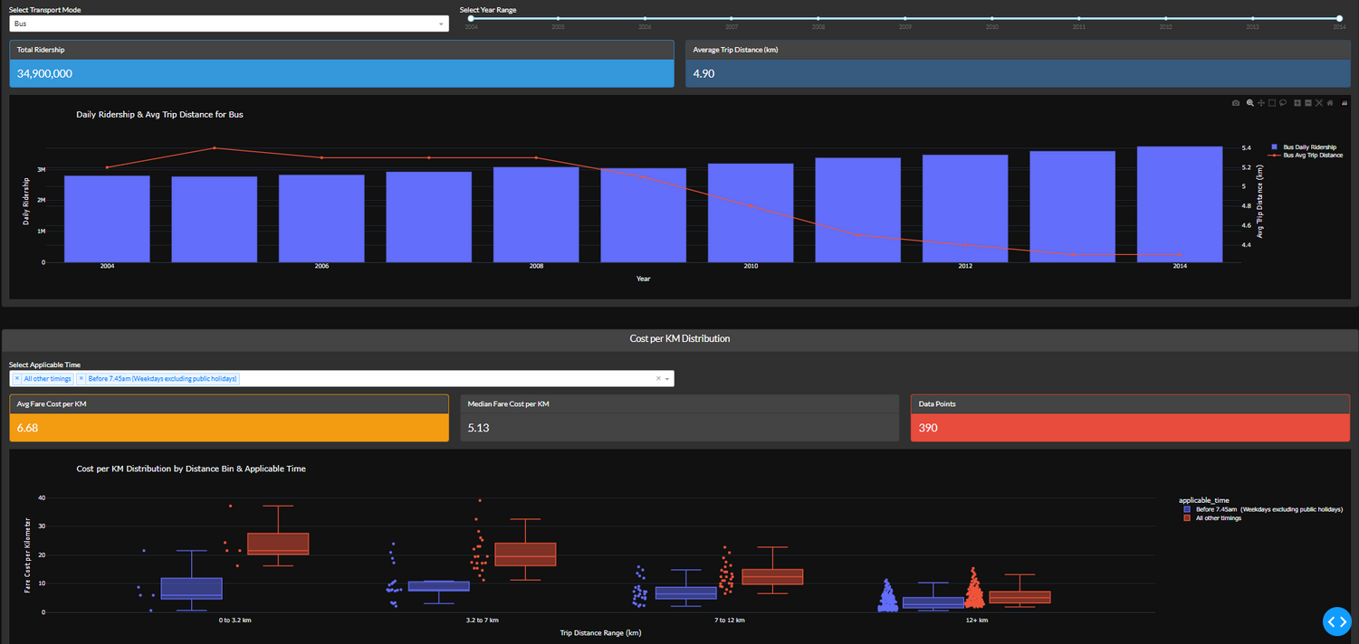
DASHBOARDS

Slide 10

DATASETS USED
daily_ridership
Provided Dataset
mrt_fares
https://data.gov.sg/datasets?query=fare&page=1&resultId=d_2ca29f673b89e0cfddbb7c74516fa4d3
trip_distance
https://data.gov.sg/datasets?query=Utilisation+Average+Trip+Distance&page=1&resultId=d_1e8c9a3f599bca92c76bdb7d8a52a79a

Slide 11

Borcelle
Thank You

